Slide 1




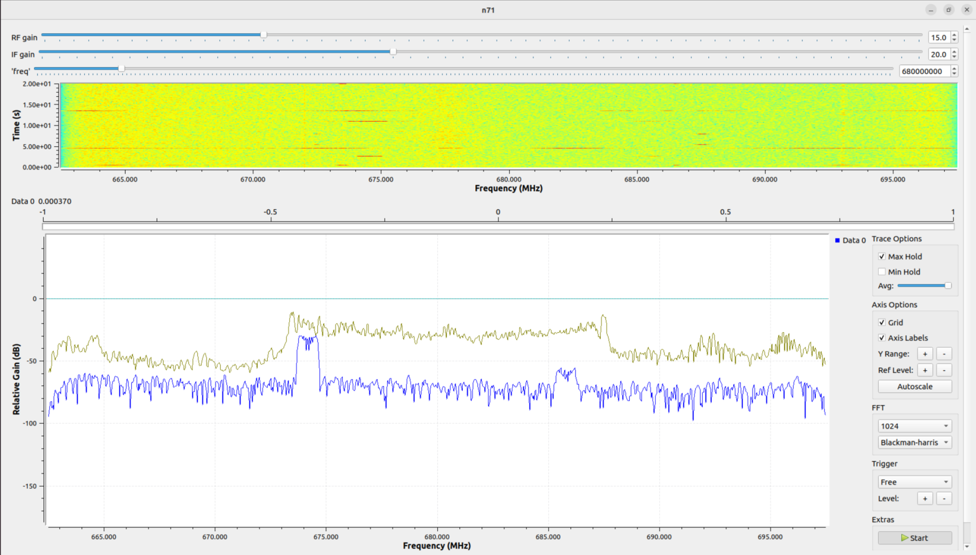
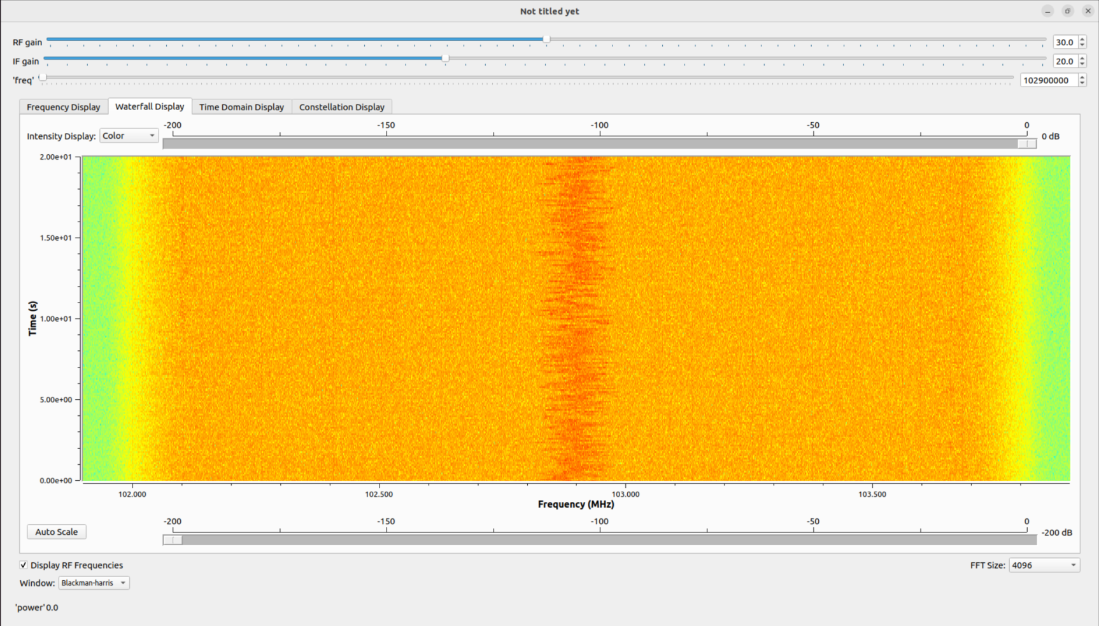
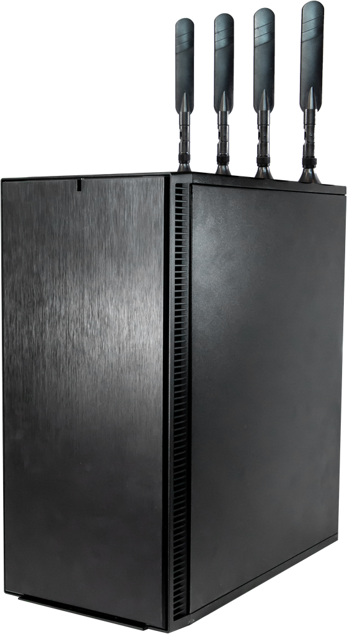



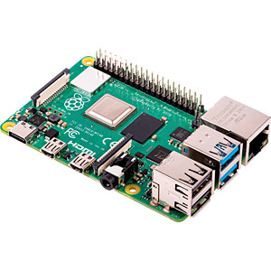
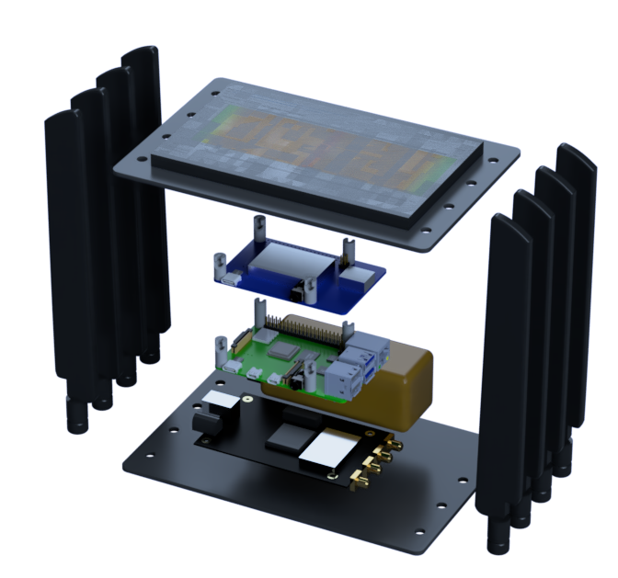
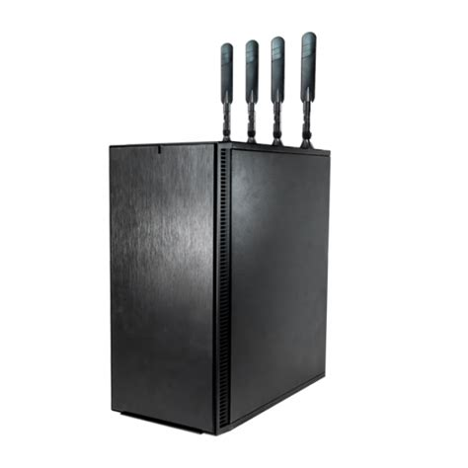

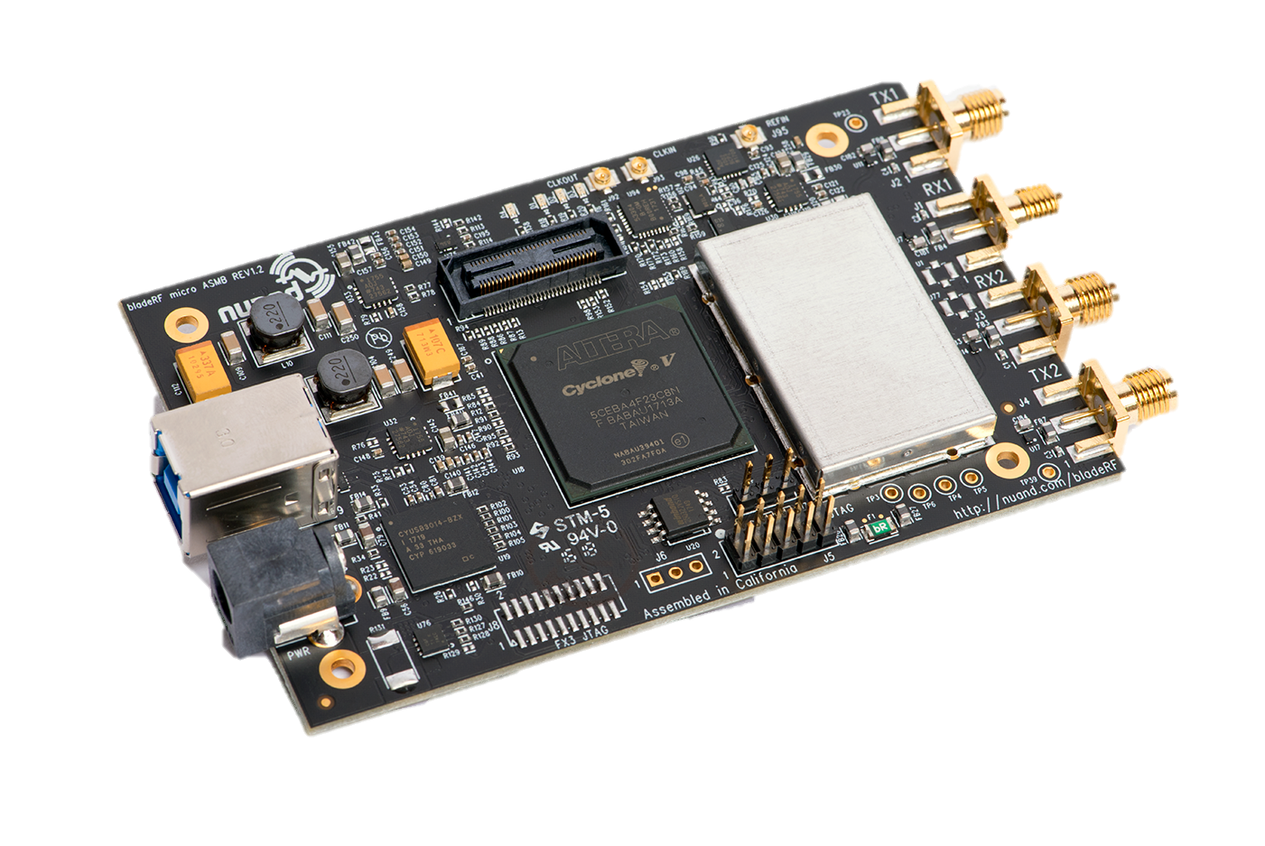
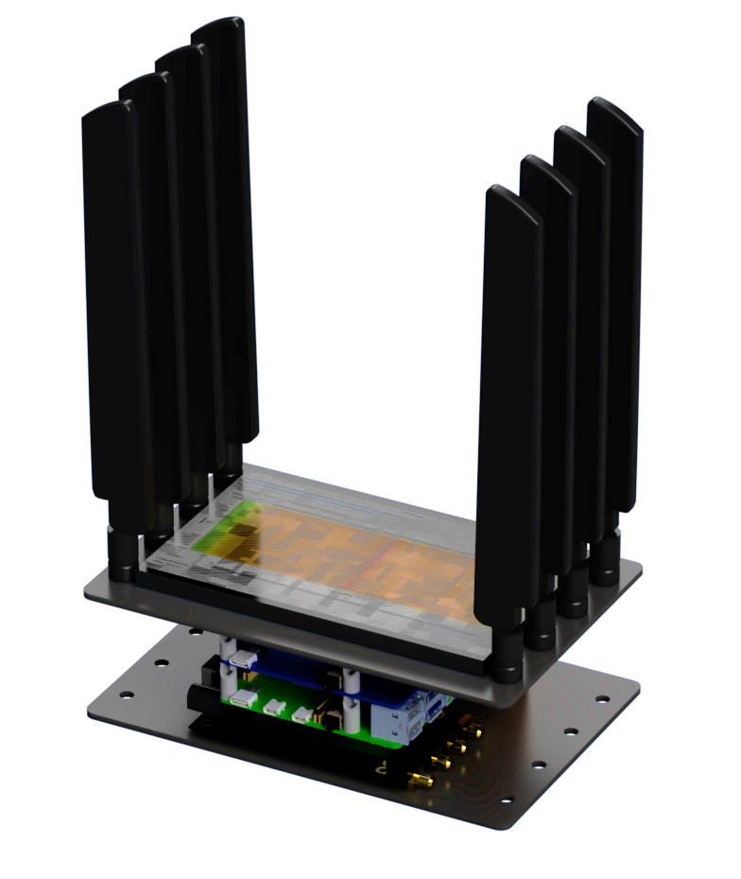
5G-Enabled IoT Gateway and RF Measurement Platform
Andrew Grow
Advisor: Dr. Dimitrie Popescu
Introduction
Software Considerations
Results
TestBed
The purpose of the 5G IoT Gateway and RF Measurement Platform is to be used onboard the USS Wisconsin as a mobile testing solution to understand and evaluate the viability of 5G systems onboard ships.
The device will be assembled using Commercial Off-the-Shelf (COTS), cost-effective components and used for performance testing of 5G New Radio (NR) and Internet-of-Things (IoT) devices.
Software Solutions are needed to run on the embedded computing device to interface with the SDR as well as run other critical tasks.
Software Defined Radio Software
GNU Radio[2]
Free, open source
Provides signal processing blocks
Supports wide range of SDRs
Widely used
SoapySDR[11]
Reliable API interface for many SDR devices
Supports several programming languages
Open source
Ideal for custom SDR applications
Pothos SDR[8]
Windows compatible
Provides flowgraph GUI
The 5G Gateway will connect to an Amari Callbox Ultimate acting as a 3GPP compliant eNodeB, the equivalent of a 5G base station transceiver in order to facilitate the testing of NR and IoT devices.
The callbox can be configured to provide many different types of service to the 5G Gateway.
The Amari callbox will provide the 5G IoT-Gateway with connection to the cloud through the Waveshare 5G HAT.
The above diagrams show GNU radio on the Raspberry Pi displaying measurements of the n71 5G NR band and the FM station 102.9Mhz.
The final design serves as a capable platform for measuring 5G propagation in the hull of the USS Wisconsin.
The design of the 5G IoT Gateway will allow for straightforward implementation of any future testing strategies.
Final design will include Sixfab 5G HAT and Telit FN980/FN980m Data Card due to its use case in the DoD.
The device will act as an IoT Gateway, collecting data from various types of sensors and making that data available to the cloud.
The device will include an RF measurement platform to determine the signal strength of frequencies of interest as well as logging that data for future analysis.
Concept of Operation
Hardware Considerations
Chosen Design
Monitoring Station
Several hardware components are needed to satisfy the project requirements.
Embedded Computing Device
Raspberry Pi[5]
~$250, 8GB RAM, 4 core ARM, WiFi, 8GB LPDDR4 RAM
Large community, well supported, 2 USB 2.0, 2 USB 3.0
Asus Tinker Board[12]
~$280, 8GB, 4 Core ARM, 4GB LPDDR4 RAM
Included mPCIE slot for LTE card, full size HDMI
Orange Pi 5B[7]
~$131(16GB version), 8 core Cortex-A76, 32GB LPDDR4 RAM
Different Form Factor from R-Pi and AsusTB, 3 USB Ports
Software Defined Radio
HackRF One[6]
$340, 1MHz-6GHz Freq. Range
20 MHz max bandwidth, Half-Duplex
8-digit RX/TX ADC, 8 – 20 Msps
USRP B200[13]
$1287, 70MHz-6GHz Freq. Range
56 MHz Bandwidth, Full-Duplex 2TX, 2RX channels
12-digit TX/RX ADC, 56 Msps
bladeRF 2.0 micro xA4[4]
$540, 47MHz – 6GHz Freq. Range
56 MHz Bandwidth, 2x2 MIMO
12-digit TX/RX ADC, 61.44 Msps
5G modem
Waveshare SIM8202G-M2 5G HAT[9]
$305
SnapDragon X55 chip with SIM8202G-M2 modem
Up to 2.4GHz DL, 500Mbps UL
Designed for R-Pi style boards, USB 3.0 interface, GNSS(GPS)
SixFab Raspberry Pi 5G Development Kit[10]
$595, Quectel RM502Q-AE
5.0 Gbps DL, 1 Gbps UL, USB3.0 Interface
GNSS(GPS/GLONASS/BeiDou/Galileo)
Waveshare 5G Dongle Module[1]
$21.99(not sold with 5G modem)
Supports SIM82XX(SIMCom) and RM50XQ(Quectel) 5G modules
Embedded Computing Device
The Raspberry Pi was chosen to interface with the SDR and 5G modem
Energy efficient quad core processor with up to 8GB of RAM and versatile connectivity that includes the GPIO header allowing connection with "hardware attached on top" (HAT) devices.
Many SDRs and 5G modems have well developed support for the Raspberry Pi
SDR Software
GNU Radio will be used
Open-source design allows for easy integration with custom programs.
RF Spectrum
Network Status:
Connected
Latency: 102ms
Upload: 5.29 Mbps
Download:44.42 Mbps
5G modem
IoT Sensors
Record Data Point
Reset Data Log
5G NR
Email Data Log
RF measurement platform
Connected to : n77
n71
-23.6 dBm
n77
-23.2 dBm
Embedded Computing Device
Wi-Fi AP
n79
-26.5 dBm
n78
-19.3 dBm
5G connectivity
In order to supply the embedded computing device with a connection to a mobile network, a 5G modem will be used. It will use a USB 3.0 connector to interface between the modem and the embedded computing device.
IoT Gateway
Wi-Fi Access Point(AP) to host IoT sensors.
Collect data from various sensors including rf measurement device.
Post data to website.
Allow data to be accessed elsewhere over the network.
RF Measurement Platform
Measure power of several 5G bands on interest
n71, n77, n78, n79.
Data Logging
Log data to .csv file.
Will measure network speed and latency.
Logged data will also include GPS position, network status, and power of 5G bands.
Allow the .csv file to be emailed to specified user.
Website hosted on Raspberry Pi to display RF measurements and 5G modem information.
Status of mobile network
Latency
Upload Speed
Download Speed
Relative power of n71, n77, n78, n79 bands
Connection band as well as capability to connect to specific band
Data logging interface
Record Data Point
Reset the current log of data
Email Data log to hardcoded recipient
Software Defined Radio
bladeRF 2.0 micro xA4
Chosen for its balance of features and price.
2x2 MIMO allows for more functionality as well as higher sampling bandwidth.
5G Modem
Chosen for its support for the Raspberry Pi
SIM8202G includes all necessary bands for receiving signals from Amari Callbox.
[1] “5G Dongle Module”. Waveshare. https://www.waveshare.com/23253-5200.htm (accessed March 19, 2023).
[2] “About GNU Radio.” GNU Radio. https://www.gnuradio.org/about/ (accessed March 19, 2023).
[3] “amarisoft AMARI Callbox Ultimate.” amarisoft https://www.amarisoft.com/app/uploads/2022/10/AMARI-Callbox-Ultimate.pdf (accessed March 19, 2023).
[4] “bladeRF 2.0 micro xA4”. Nuand. https://www.nuand.com/product/bladeRF-xA4/ (accessed March 19, 2023).
[5] “Datasheet - Raspberry Pi 4 Model B”. Raspberry Pi. https://datasheets.raspberrypi.com/rpi4/raspberry-pi-4-datasheet.pdf (accessed March 19, 2023).
[6] “HackRF One”. HackRF. https://hackrf.readthedocs.io/en/latest/hackrf_one.html#features (accessed March 19, 2023)
[7] “Orange Pi 5B”. Orange pi. http://www.orangepi.org/html/hardWare/computerAndMicrocontrollers/details/Orange-Pi-5B.html (accessed March 19, 2023).
[8] “pothosSDR”. Github. https://github.com/pothosware/PothosSDR/wiki (accessed March 19, 2023).
[9] “SIM8202G-M2 5G HAT for Raspberry Pi”. Waveshare. https://www.waveshare.com/sim8202g-m2-5g-hat.htm (accessed March 19, 2023).
[10] “Sixfab – Raspberry Pi 5G Development Kit”. Sixfab. https://sixfab.com/product/raspberry-pi-5g-development-kit-5g-hat/ (accessed March 19, 2023).
[11] “SoapySDR”. Github. https://github.com/pothosware/SoapySDR/wiki (accessed March 19, 2023).
[12] “Tinker Board R2.0”. tinker board. https://tinker-board.asus.com/product/tinker-board-r2.html (accessed March 19, 2023).
[13] “USRP B200/B210 Bus Series”. Ettus Research. https://www.ettus.com/wp-content/uploads/2019/01/b200-b210_spec_sheet.pdf (accessed March 19, 2023).

